Slide 1
Awareness and Empowerment When Studying Abroad

Slide 2
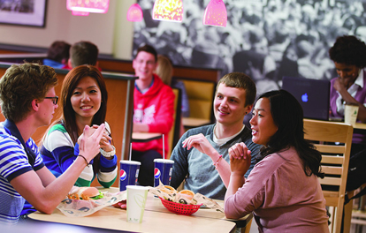
Cultural Sensitivity
Doorway to a positive cultural experience
Never a reason to submit to uncomfortable behavior or compromise your ethics
If feel uneasy – get out of the situation
Never sacrifice sense of safety for cultural sensitivity
Notes:
Examples are all things that can have different meanings and connotations in different countries for example Being seen with a male or talking to a female – different meanings could be sacrificing the safety of a woman in the host country.

Slide 3

Sexual Orientation and Gender Identity
Social climate, laws and personal interactions involving sexual orientation may be different
Research the GLBT climate
Amnesty International
SCSU International Studies website
http://www.stcloudstate.edu/studyabroad/orientation/lgbt/
Be aware that same sex touch may have different meanings – don’t assume
Know the laws
You may need to change your behavior to stay safe
Notes:
Listed organizations have websites with info about LGBT climates in different countries

Slide 4
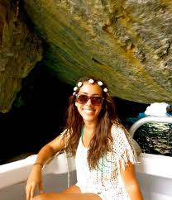
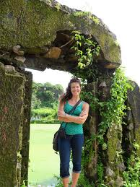
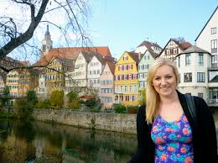
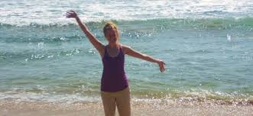
Traveling Issues for Women
American woman's cultural bias that we are capable, independent and that it is our right to do anything that a man can do and go anywhere that a man can go.
Unfortunately, this is not how it is in many other countries.
Be informed – talk to other women that have traveled in the country you are going to.

Slide 5
Sexual Harassment
Know the laws
What may be illegal here may not be in host country
Do not relax your personal boundaries
Don’t feel compelled to return unwanted attention or engage in conversation
Make body language match your words
Be familiar with University Policy
Notes:
University policy applies while you are studying abroad – violations of the policy can result in a student having to leave the program and return to the U.S.

Slide 6

Unwanted Attention -Effective Techniques
Ignore
Pretend ignorance
Feign confusion
Move away
If doesn’t work – be assertive
Broken record technique
Notes:
Would you like to go to the movies with me?
No thank you I can’t go.
Oh come on. Its just a movie.
No thank you.
I’ll get you back early.
No thanks. I’m not interested.
Oh you’re too goo for me, is that it?
No thank you. I can’t go.

Slide 7
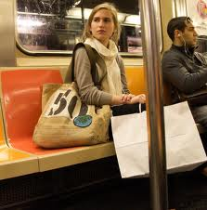
Sexual Assault Factors that increase risks
Being a tourist & standing out
Not knowing local customs
Not knowing the language well
Traveling on public transportation
Have not learned the cultural way to say no
May not yet pick up clues of danger
Being out late or in high crime areas
*Drinking too much makes you a target for crime
*Believing it can never happen to you makes you more vulnerable
Notes:
Sexual assault rates in the US may be higher than many other countries but you may be at higher risk traveling.
Alcohol can increase your risk and believing it can never happen to you can increase your risk because then you are not looking for warning signs. Don’t have to be paranoid – just be aware.

Slide 8
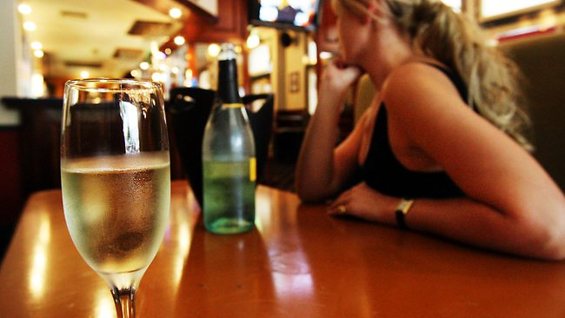
RECENT UN STUDY
A new U.N. report on narcotics use says ‘date-rape drugs" are on the rise worldwide.
Sexual assault crimes are often
committed in public places such as
bars, restaurants, nightclubs but also in private surroundings.
What is alarming is the unscrupulous way in which those drugs are used upon unwitting victims — the drugs, which are usually disguised in food or drinks, are introduced in dosages that are significantly higher than the dosages used for therapeutic purposes —a practice which entails serious health risks for the victims.
Notes:
Be aware that alcohol is still the number one drug that is used to commit a sexual assault but other drugs put into drinks does happen.

Slide 9

Gift of Fear How Predators Manipulate
Establish premature trust
Charm for self-gain
Too many details
Unsolicited giving to create indebtedness
Unsolicited promises/false promises
Discounting no

Slide 10
Progressive Invasions
Start with a touch
You may feel wary but talk yourself into thinking you are overreacting
He is thinking – How much will she tolerate, how long can I get away with this before she calls me out?

Slide 11
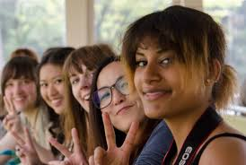
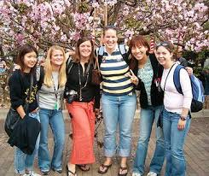
Minimize Risk
Learn norms & ways to stay safe from Women in the host country
Pay attention to your inner
voice & fear response
Travel together & know where
you are going
If going out stay in a group & don’t leave anyone behind
Familiarize yourselves with phrases and
gestures that may be interpreted as
signaling sexual availability

Slide 12
Strategies used by other students
Listen to what is being said around you
Be alert to suspicious activity
Walk in well lit areas only at night
Know where to go for help

Slide 13
If something happens…
Talk to a faculty/staff - been given specific information
Sexual Assault Support & Help For Americans Abroad, SASHAA
Call or email the Gender Violence Prevention Program- confidential
Call Public Safety & asked to be transferred
Support one another – don’t question or blame
Notes:
Another student on the program – need to get in touch with the programs listed for assistance.

Slide 14
Resources
Materials for this presentation relied on information from various sources including:
Purdue University Student Health Centers ppt for student abroad
Univ of Calif. Education Abroad Program
Univ. of Delaware
Univ. of Nevada, Los Vegas Study Abroad Handbook
SAFETI Peace Corp Rape Response Handbook
Presentations by Nancy Newport RN, LPC, Consultant to Peace Corp
Thank you to Joe Dempsey, SCSU Graduate Student for formatting this ppt.

